Slide 1
A Major Lifestyle A Follow up to The True Meaning behind “Decision Day”
Nikita Jones
Anusha Rama
Edward Gates, Jr.
Danica Rios
Mason Waters

Slide 2
Agenda
Project Purpose
Problem Analyzed/Visualized
Learned Technologies Used
Machine Learning

Slide 3
Project Purpose
Serves as a follow up to Project #1 where there was analysis and comparison of starting, mid-career, and 90th percentile salaries based on College Type, Major and Region of institution
This project aims to predict which region the user lives in based upon Mid-Career salary and lifestyle preferences.

Slide 4
Problem Analyzed/Visualized
Project #1 sought to discredit the notion that higher tuition rates exclusively resulted in higher salaries.
With machine learning, this project seeks to predict the region in which a user lives by examining the historical data of residents within a select region and the average living expenses in the selected region.

Slide 5
Technologies Used/Explored
Python
Pandas
Sklearn
BeautifulSoup
Browser
Deepcopy
Numpy
Tableau
Amazon AWS
HTML/CSS Bootstrap

Slide 6
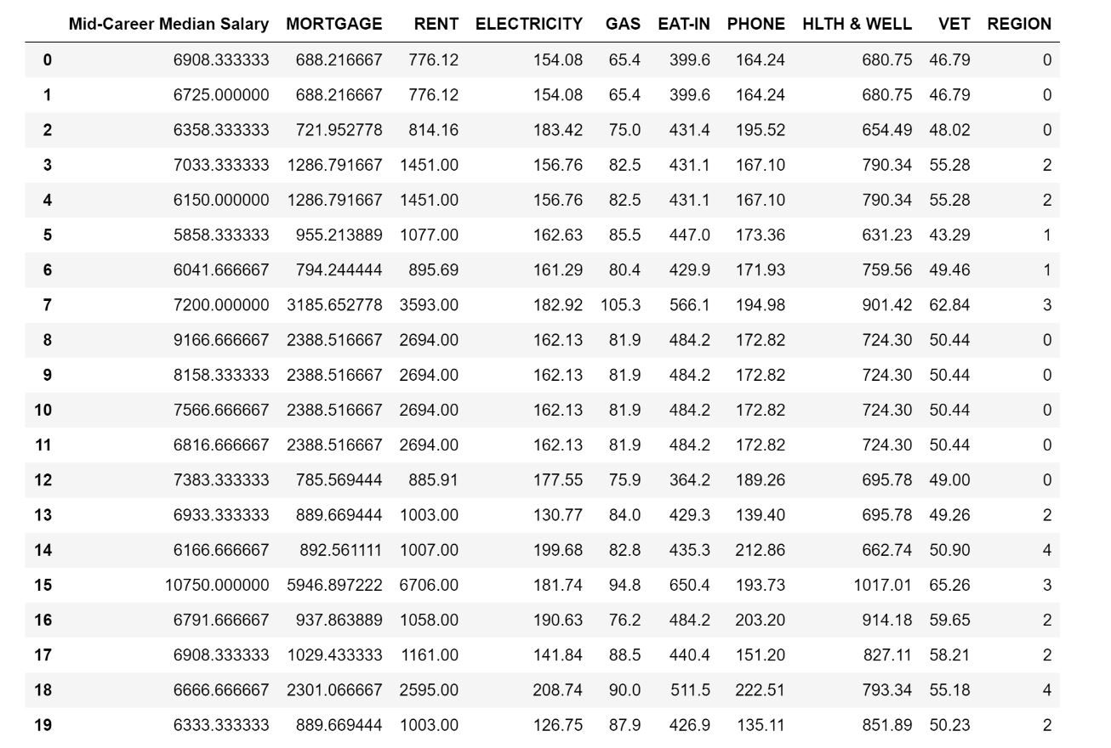
Machine Learning
Training
80%
Testing
20%
Predict
72% Accuracy

Slide 7
Visualization

Slide 8
?
Any questions?
?
?

